Slide 1
BFF(Backend For Frontend) with AKKA HTTP
Yang Li, Denis Konakov

Slide 2


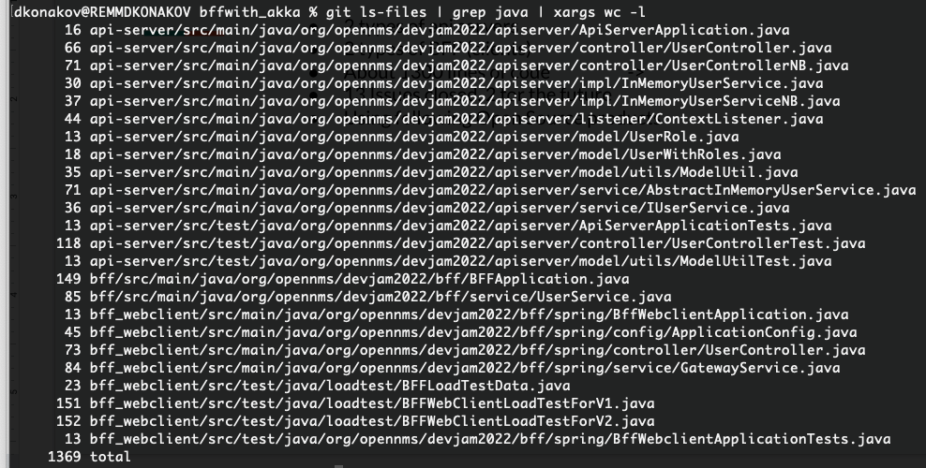

Little bit information about the project
2 types of API servers
2 types of BFF (clients)
About 1300 lines of code
13 Issues closed, 2 for the future
Using following Open Source products
Notes:
Little bit about the project in nutshell (what we have done in 4 days)

Slide 3
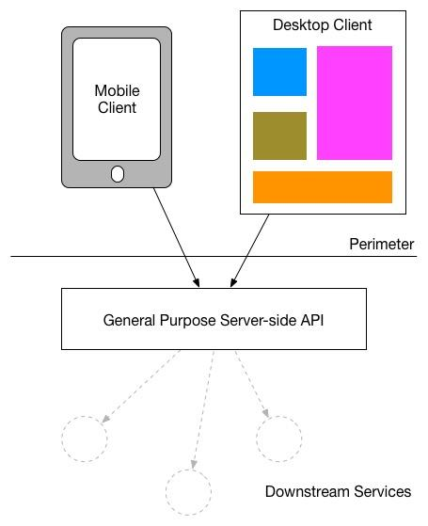
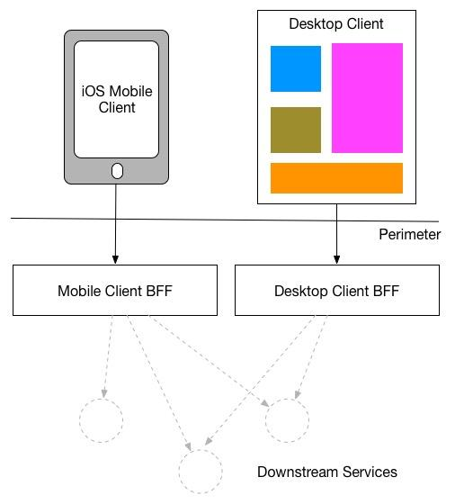

General Idea of BFF
From
To
More here: https://samnewman.io/patterns/architectural/bff/

Slide 4
The main purpose of this project
Evaluate the performance of BFF implemented with AKK HTTP as developer
Compare the performance of AKK HTTP BFF with BFF implemented with Spring Boot Webflux

Slide 5
And now about our architecture… seriously…
getUserList only
Simple SpringBoot based LT
V1
AKKA based BFF
Simple REST API
InMem
[HashT]
SpringBoot
“Reactive” REST API
JMeter based LT
WebClient based BFF
V2
getUserList
getUserById
addUser

Slide 6
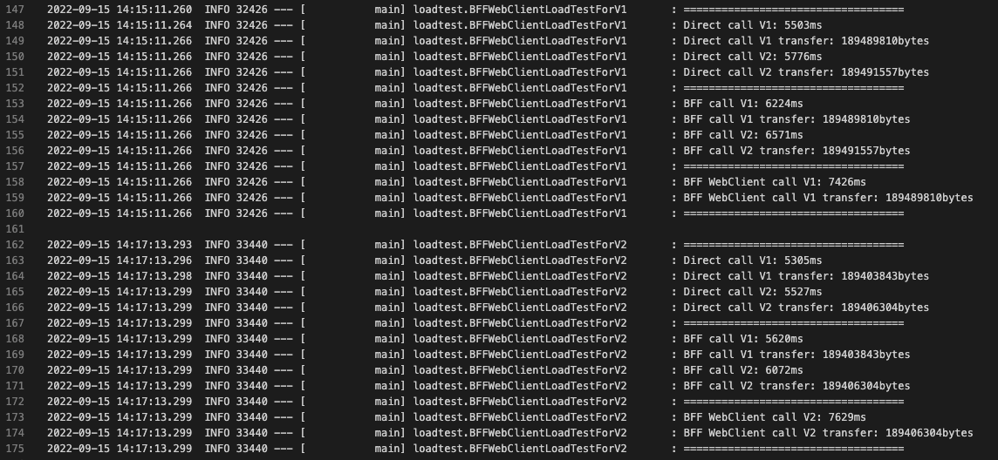
Results (Simple LT): Unit test with API server in Docker

Slide 7
JMeter load tests
API server and BFF were running from IntelliJ as Spring/Java application
When testing AKK HTTP BFF, both application were running without any VM parameters
When testing Spring WebClient BFF, we have start API and BFF with “-Xms1g -Xmx4g”

Slide 8
AKKA BFF

Slide 9
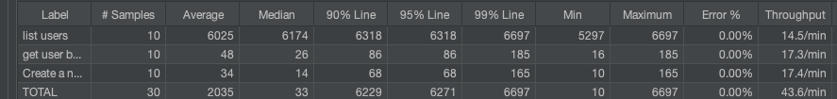
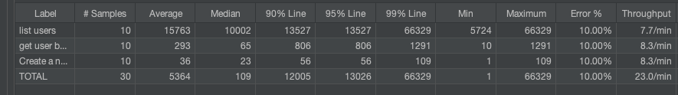
Spring WebClient BFF
The Akka HTTP version is faster and has higher throughput
When we try to increase the throughput of Spring version some requests get errors and API server get OOM

Slide 10


